Slide 1

Applications of Artificial Intelligence
Master. Cesar Sinchiguano
Robotics and Cybernetics

Slide 2
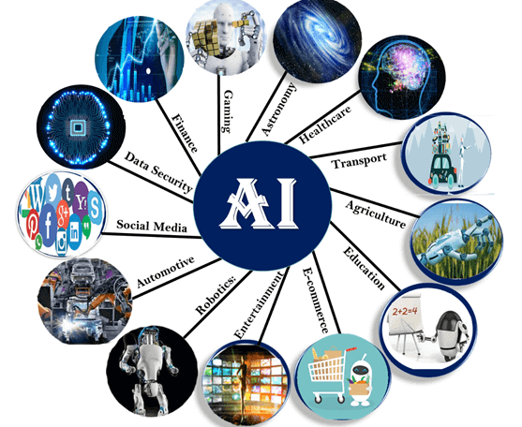
Today’s lecture
Conventional programming vs ML
What is Artificial Intelligence?
AI In Marketing
AI In Banking
AI In Finance
AI In Agriculture
AI In HealthCare
AI In Gaming
AI In Space Exploration
AI In Autonomous Vehicles
AI In Chatbots
AI In Artificial Creativity

Slide 3
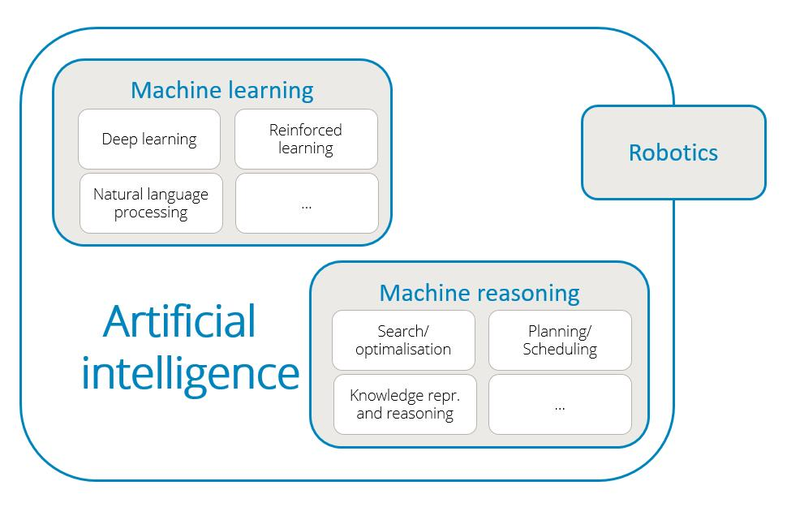

Slide 4
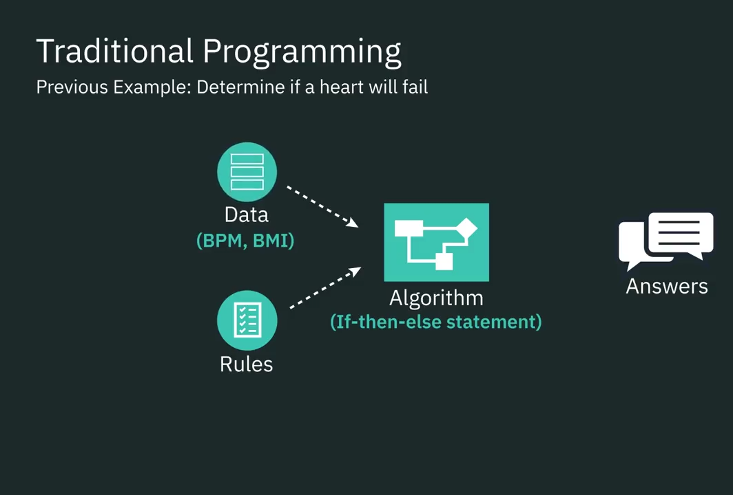
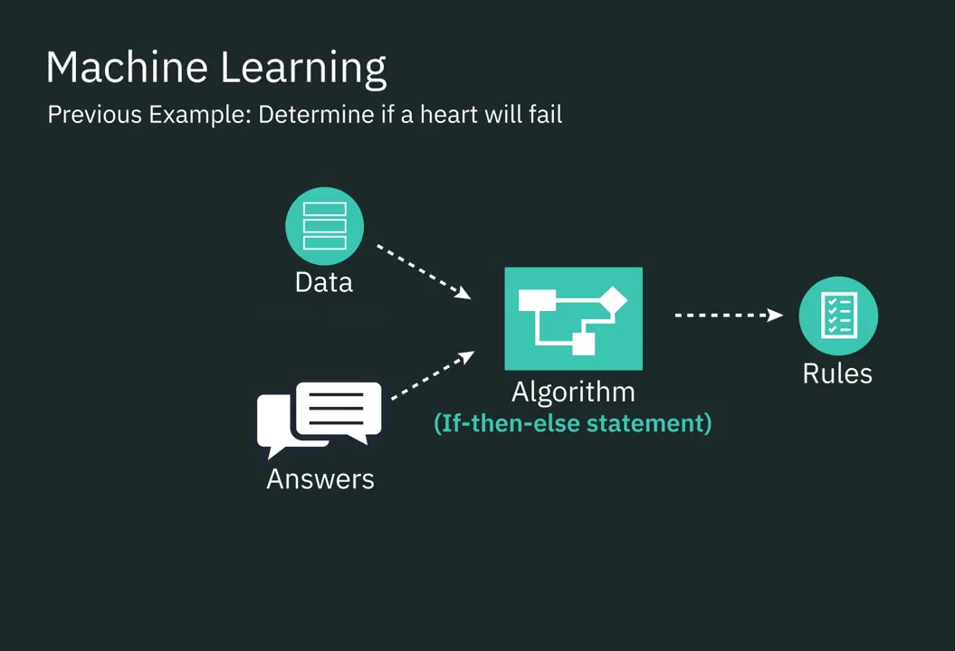
Conventional programming vs machine learning

Slide 5
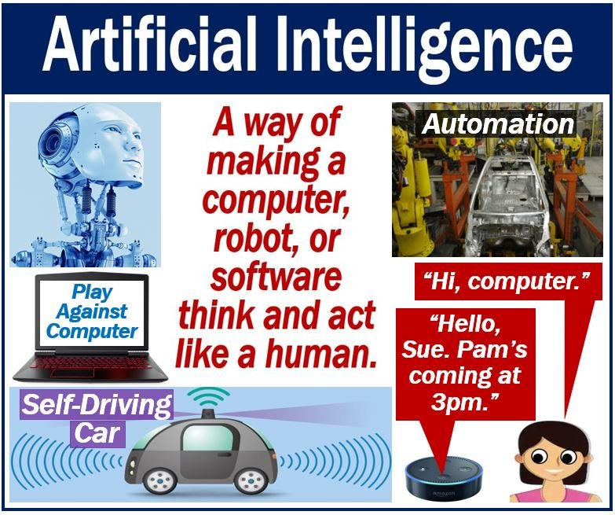
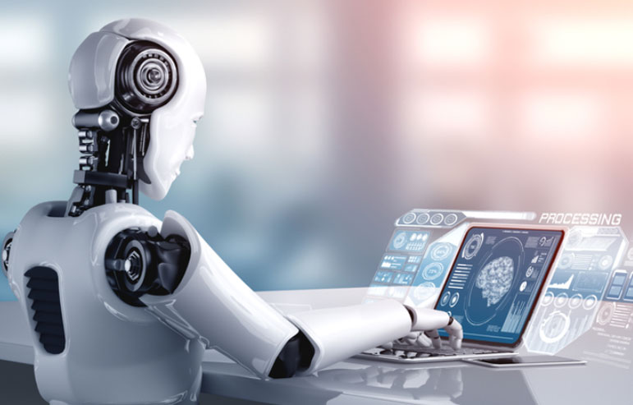
What is Artificial Intelligence?
AI is a method of programming a computer, robot, or other object to think like a smart human.
AI is the study of how the human brain thinks, learns, makes decisions, and works to solve problems.
In simple words
Artificial Intelligence is made up of the phrases Artificial and Intelligence, with Artificial referring to “man-made” and Intelligence referring to “thinking power,” so AI refers to “a man-made thinking power.”
Cognitive: relating to the processes of thinking and reasoning

Slide 6
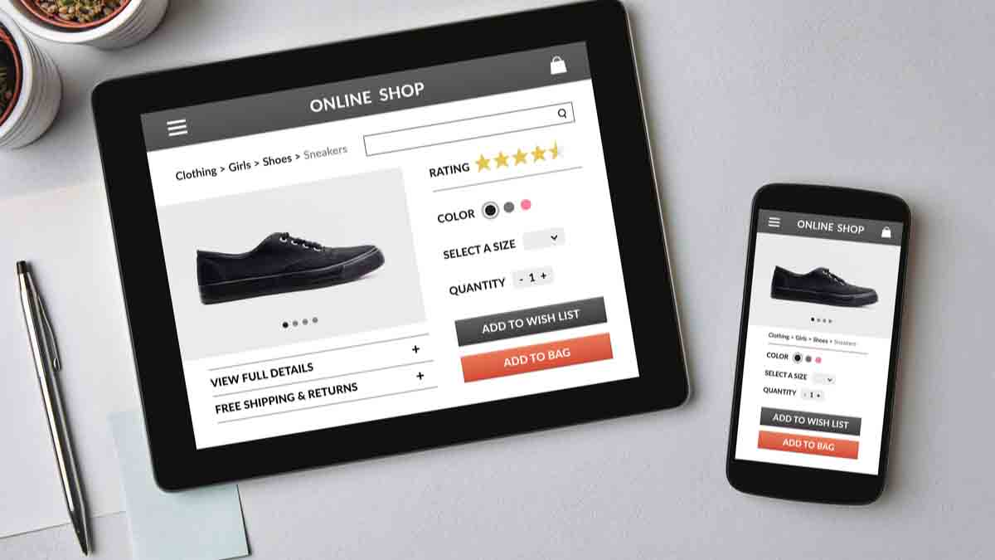
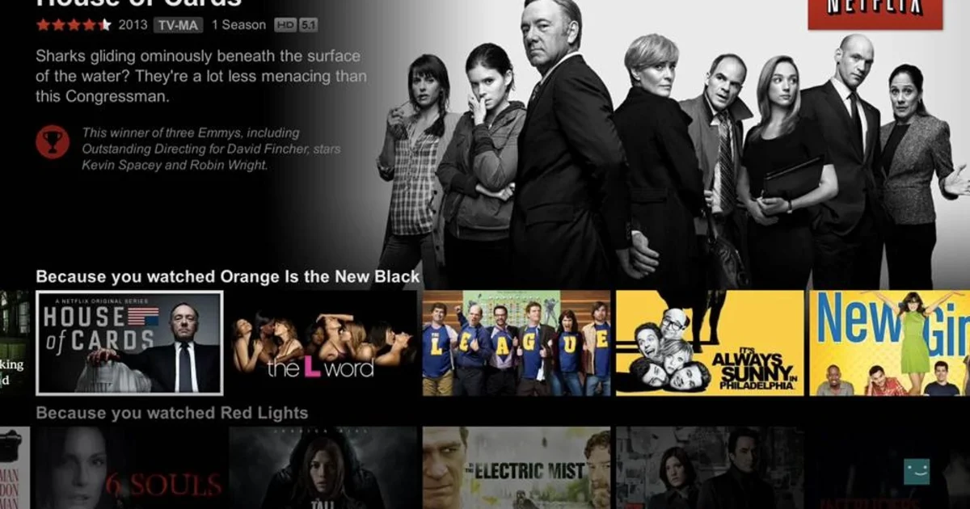
Artificial Intelligence Applications: Marketing
Marketing is a way to sugar coat your products to attract more customers.
Before, we searched an online store to find a product without knowing its exact name, it was a nightmare to find the product.
Now, we search for an item on any e-commerce store, we get all possible results. It’s like these search engines are reading our minds!
In a matter of seconds, we get a list of all relevant items. An example of this is finding the right movies on Netflix.
One reason why we’re all obsessed with Netflix. It examines millions of records to suggest movies that you might like based on your previous actions and choices of films.
As the data set grows, this technology is getting smarter and smarter every day.
Sugarcoat: to make something seem more positive or pleasant than it really is

Slide 7
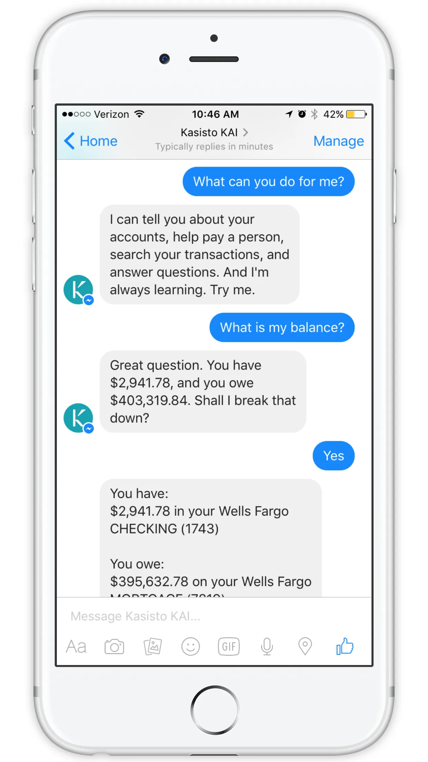
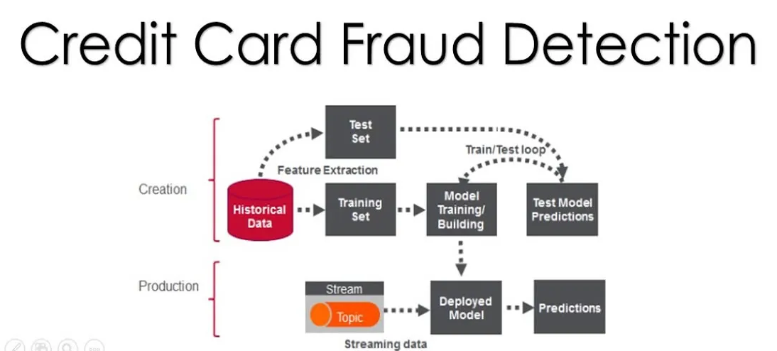
Artificial Intelligence Applications: Banking
HDFC Bank.
AI in banking is growing faster than you thought!
A lot of banks have already adopted AI-based systems to provide
Customer support,
Detect anomalies
Credit card frauds.
Companies such as MasterCard and RBS WorldPay have relied on AI and Deep Learning to detect fraudulent transaction patterns and prevent card fraud for years now. This has saved millions of dollars.

Slide 8
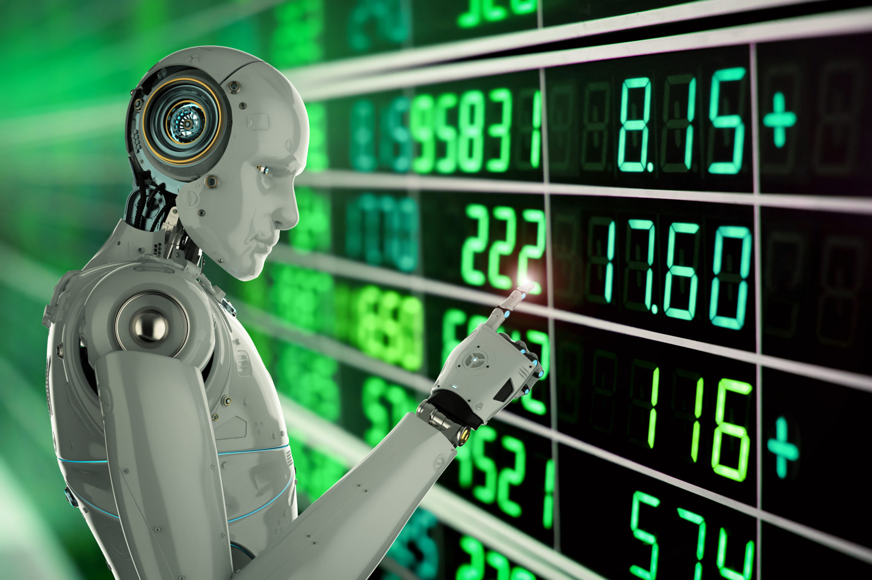
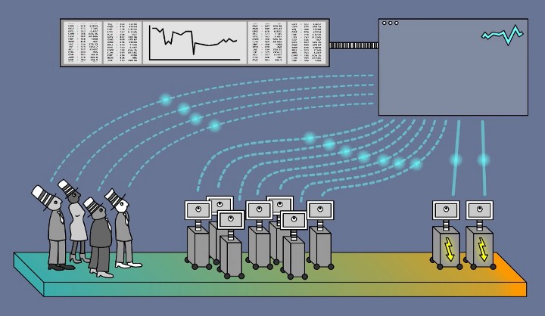
Artificial Intelligence Applications: Finance
Ventures have been relying on computers and data scientists to determine future patterns in the market.
Trading mainly depends on the ability to predict the future accurately.
Machines are great at this because they can crunch a huge amount of data in a short span
Machines can also learn to observe patterns in past data and predict how these patterns might repeat in the future.
Left traders, Center ” common machine trading systems, Right HFT high frequency trading (ML)

Slide 9
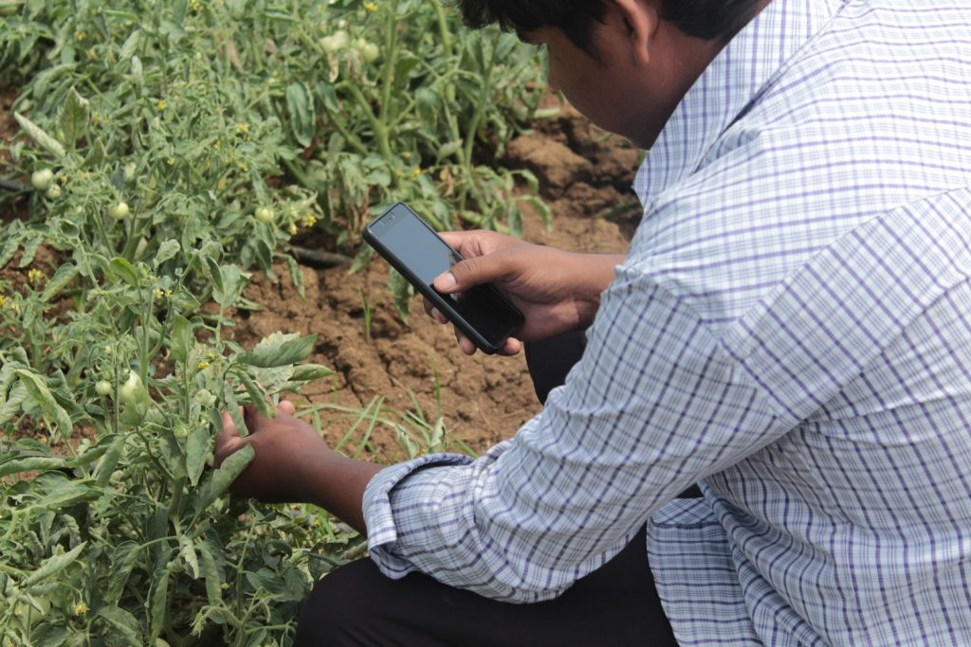
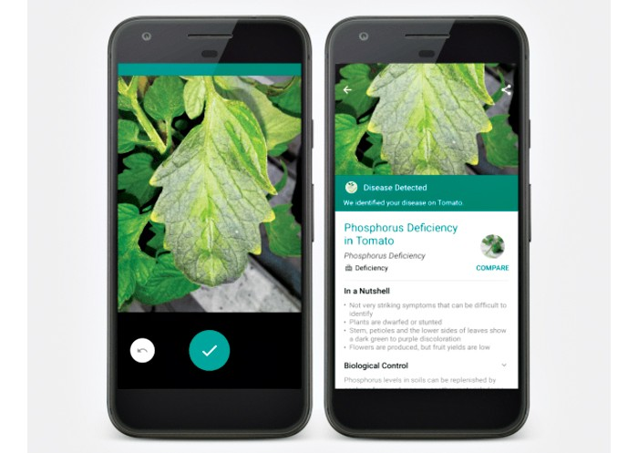
Artificial Intelligence Applications: In Agriculture
Plantix - a mobile app revolutionizes farming with a little help from AI
Plantix was developed by PEAT GmbH, a Berlin-based AI startup.
The app claims to diagnose pest damages, plant diseases and nutrient deficiencies affecting crops and offers corresponding treatment measures.
See&Spray

Slide 10


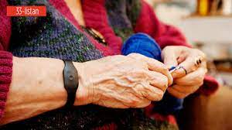
Artificial Intelligence Applications: In HealthCare
AI applications are used in healthcare to build sophisticated machines that can detect diseases and identify cancer cells.
Coala life which is a company that has a digitalized device that can find cardiac diseases.
Aifloo is developing a system for keeping track of how people are doing in home care.
The best thing about AI in healthcare is that you don’t even need to develop a new medication. Just by using an existing medication in the right way, you can also save lives.
heartMonitor
aifloo
RoboticSurgery

Slide 11
Artificial Intelligence Applications: Gaming
heartMonitor
aifloo
RoboticSurgery

Slide 12
Thanks
cesar.sinchiguano@uleam.edu.ec

Slide 13
https://www.edureka.co/blog/artificial-intelligence-applications/
cesar.sinchiguano@uleam.edu.ec

